Slide 1
How to use
Commonkind website

Slide 2
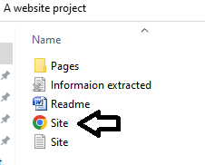
How to open?
If you want to open the website, you just need to open the Site.html
It will open in your browser.
You can use the site by clicking on the links

Slide 3
How to use?
Read everything carefully and then only click on links
After opening, you will get welcome and menu which will include the topics

